Slide 1
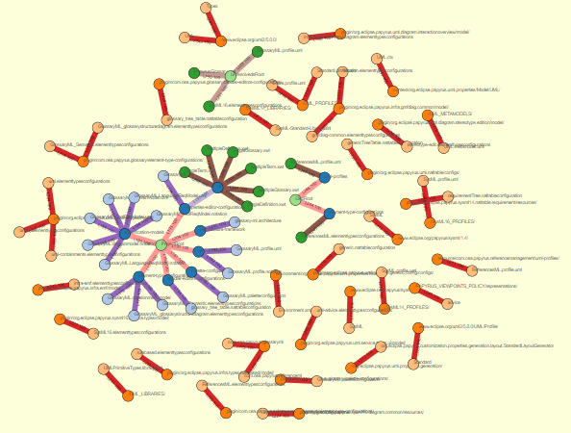
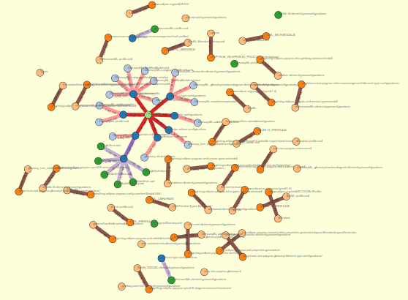
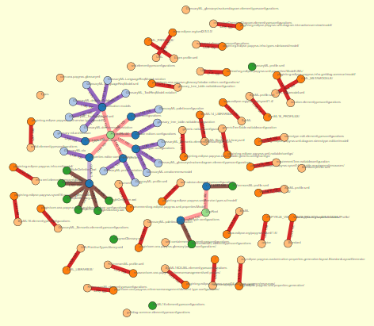
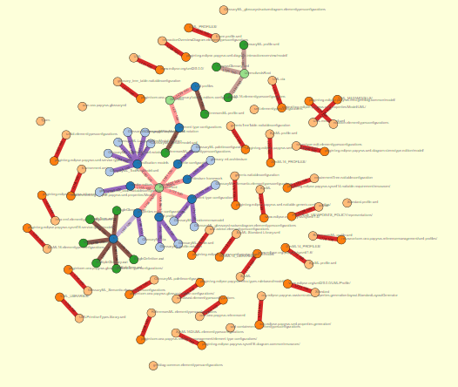
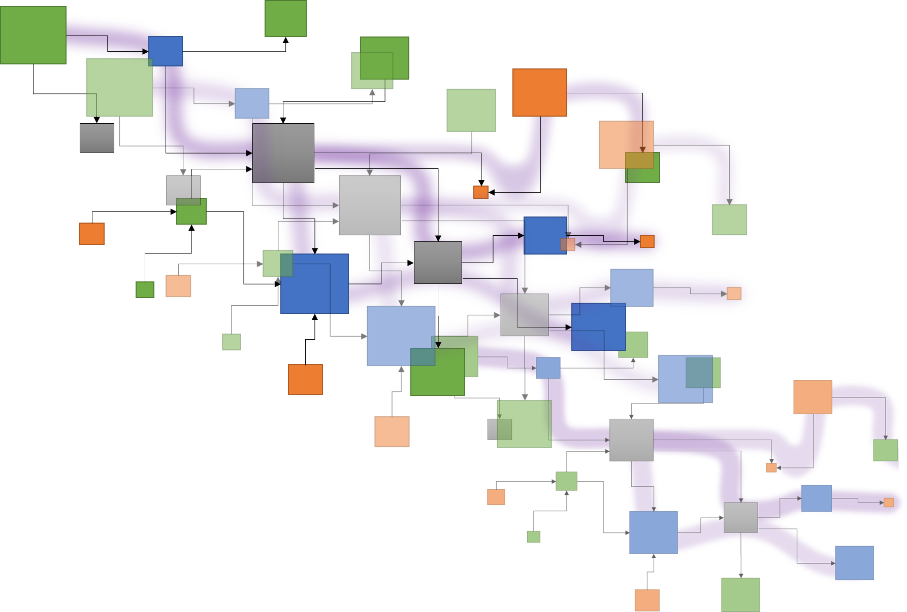
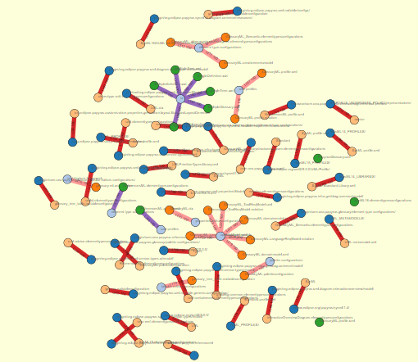





Papyrus topology and complexity an automated overview
Traceα
Deliverable 6
A study of Papyrus: Orchestration for DSL modeling
Inter-module connections
Edouard R. Batot
Mai 2022

Slide 2
Traceα
Deliverable 6
A study of Papyrus: Orchestration for DSL modeling
Inter-module connections
L3. Case study. Exploration of different scenarios that would benefit from a socio-technical
traceability language or distance functions to reduce accidental complexity thanks to tracing.
(For example: customization of views according to the "distance" between the artefacts on
a matrix heat chart) (Task 3).
Edouard R. Batot
Mai 2022

Slide 3
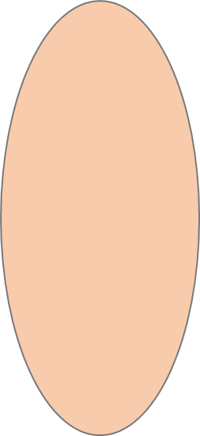
HREF, urls, and protocols…
Reference forensic
Protocol
location
name
innerlocation
Reference forensic
Without
Http
Platform
Pathmap
…
Path to “file artefact”
Artefact name
Path to element
Exploring Papyrus typology
Fragmentation
External
Location
Local
Folder
Context
resolves?
Artefact
Artefact
Protocol
External
File
exists?
Local
File
Root
Location
Artefact
File Artefacts
External locations
Name
Inner location
Artefact
Element
Precise
Artefact

Slide 4
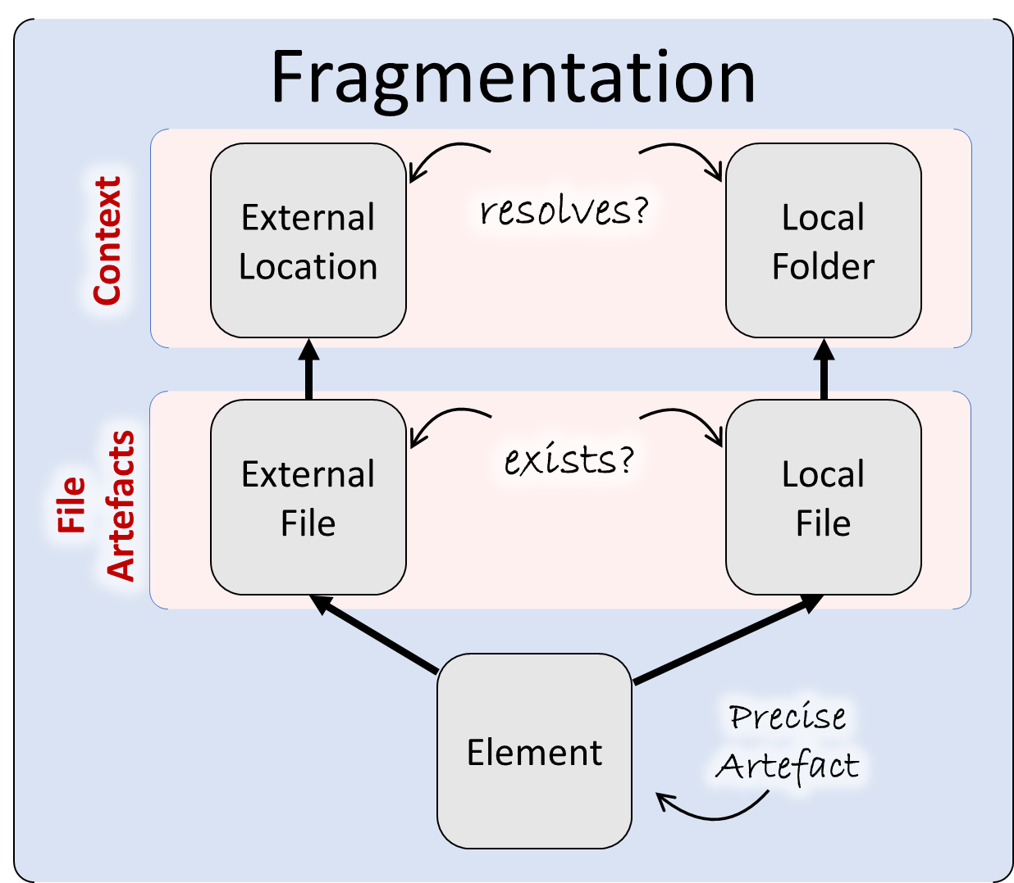
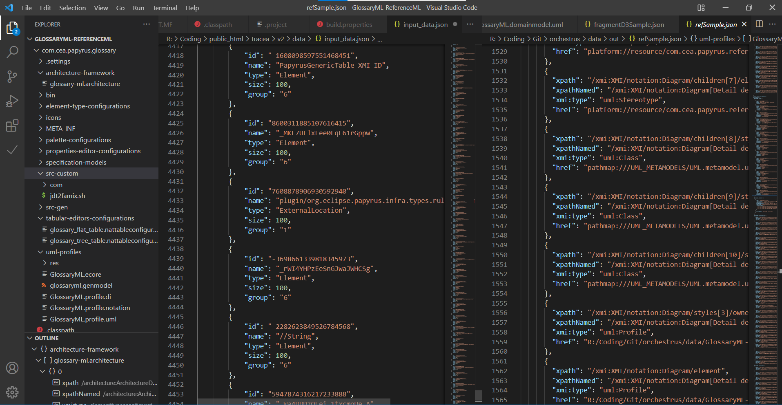
Persistence break.
Folder
File
File
File
Elt
Elt
Folder
Elt
Elt
Elt
Folder
File
File
File
File
File
File
Elt
Elt
Elt
Elt
Elt
Elt
Elt
Elt
Elt
Elt
Elt
Elt
Elt
External Location
External Location
Elt
Elt
Elt
External Location

Slide 5
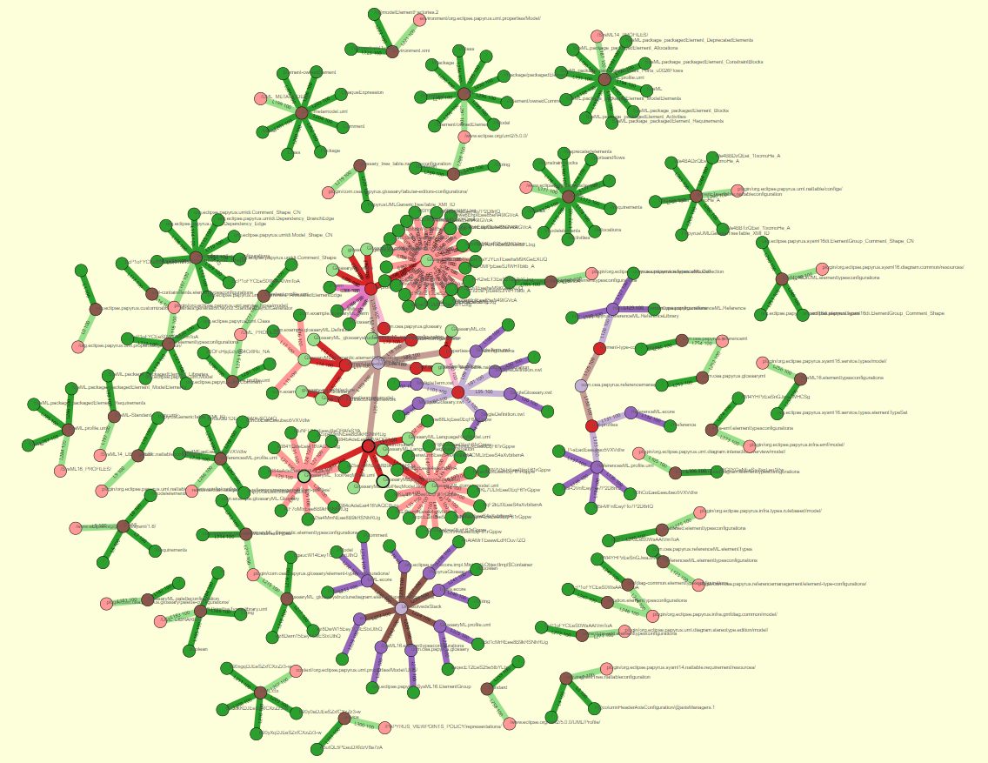
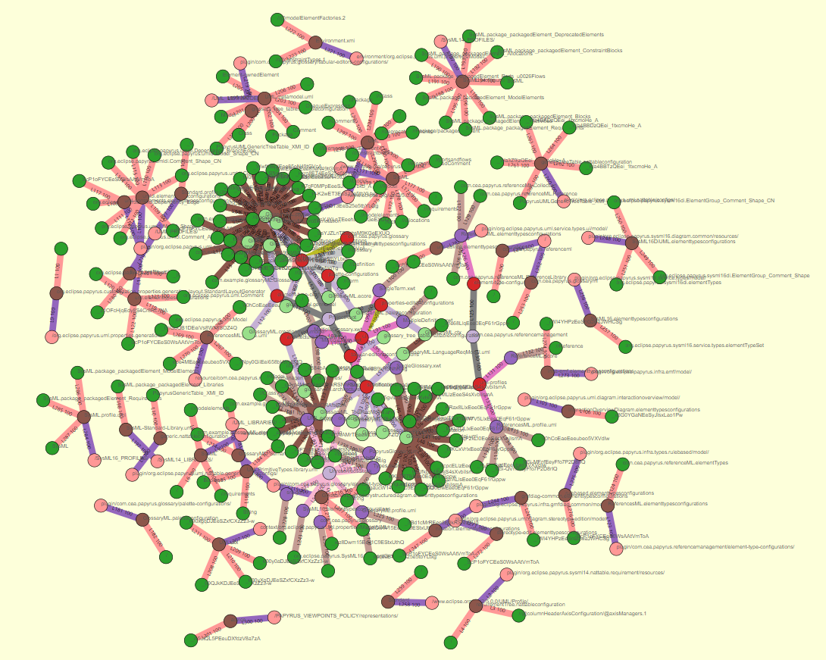
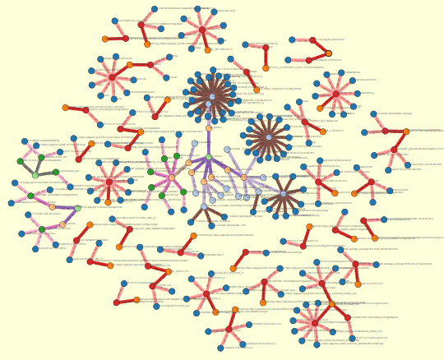
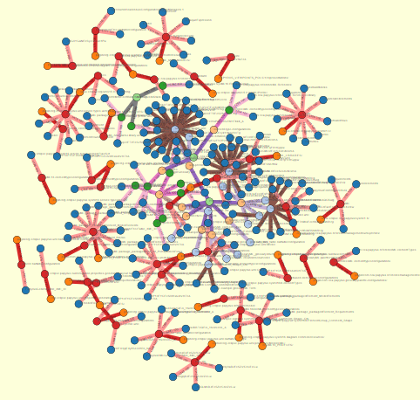
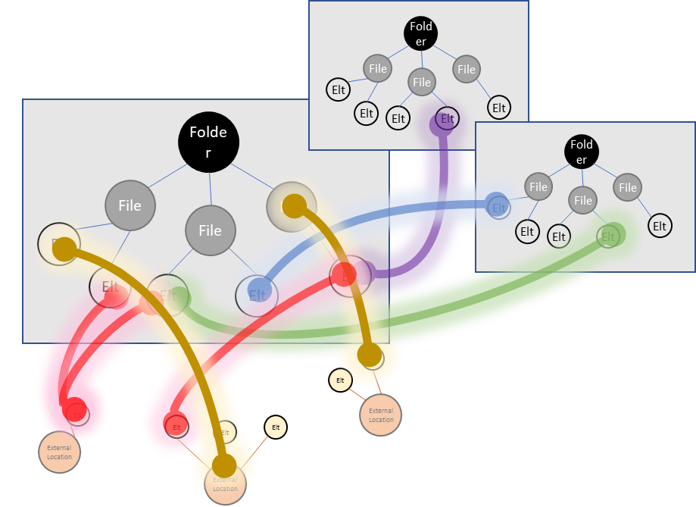
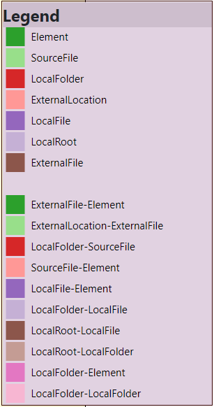
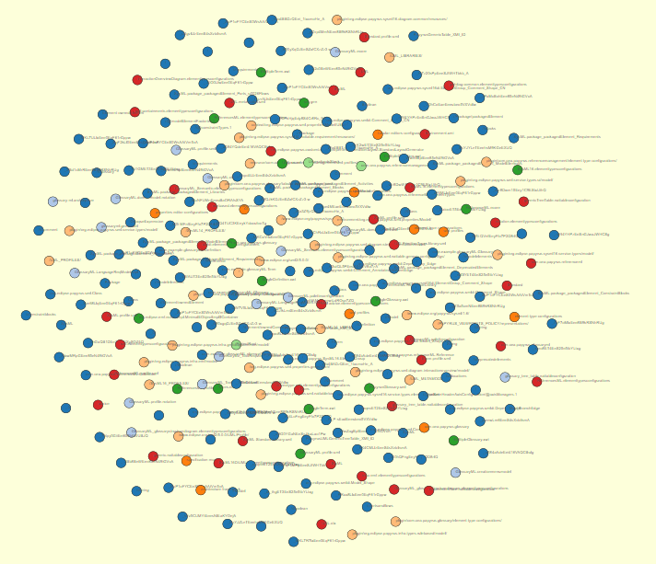
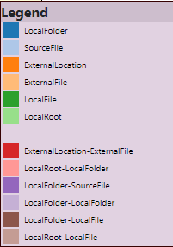
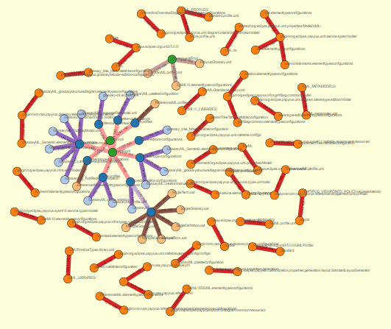
Reference identification and visualization
Fragmentation
External
Location
resolves?
Local
Folder
Context
GlossaryML
External
File
exists?
Local
File
Reference forensic
File Artefacts
Element
Precise
Artefact
Exploring Papyrus typology

Slide 6
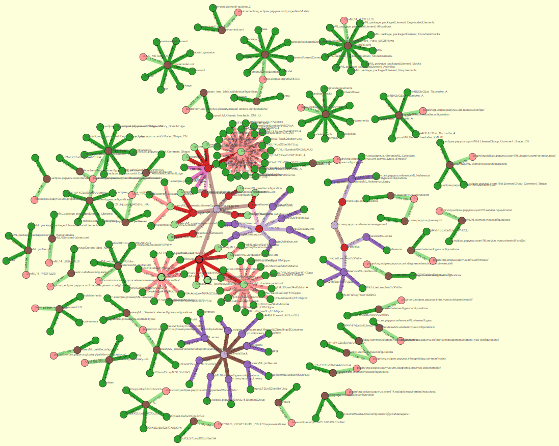
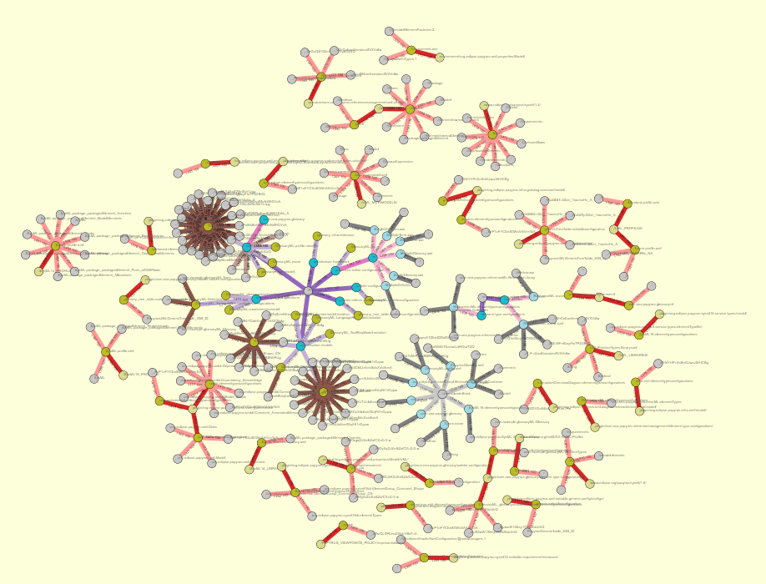
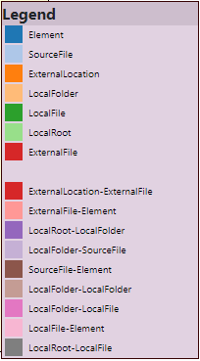
Topology and distance in a Papyrus project
Reference forensic
Exploring Papyrus typology
data/input_trace_data.json&nc=4&lc=4

Slide 7



















Topology and distance in a Papyrus project
Reference forensic
Exploring Papyrus typology
The bigger an element,
The most accessed

Slide 8
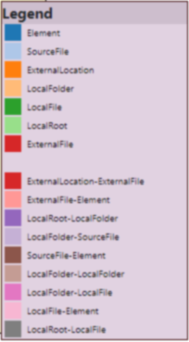
Topology and distance in a Papyrus project
Reference forensic
Distance functions to reduce accidental complexity
Customization of views according to the "distance" between artefacts
Socio-technical traceability language
Confidence / Energy valuation
Visualization parameters
Exploring Papyrus typology
A matrix heat chart

Slide 9
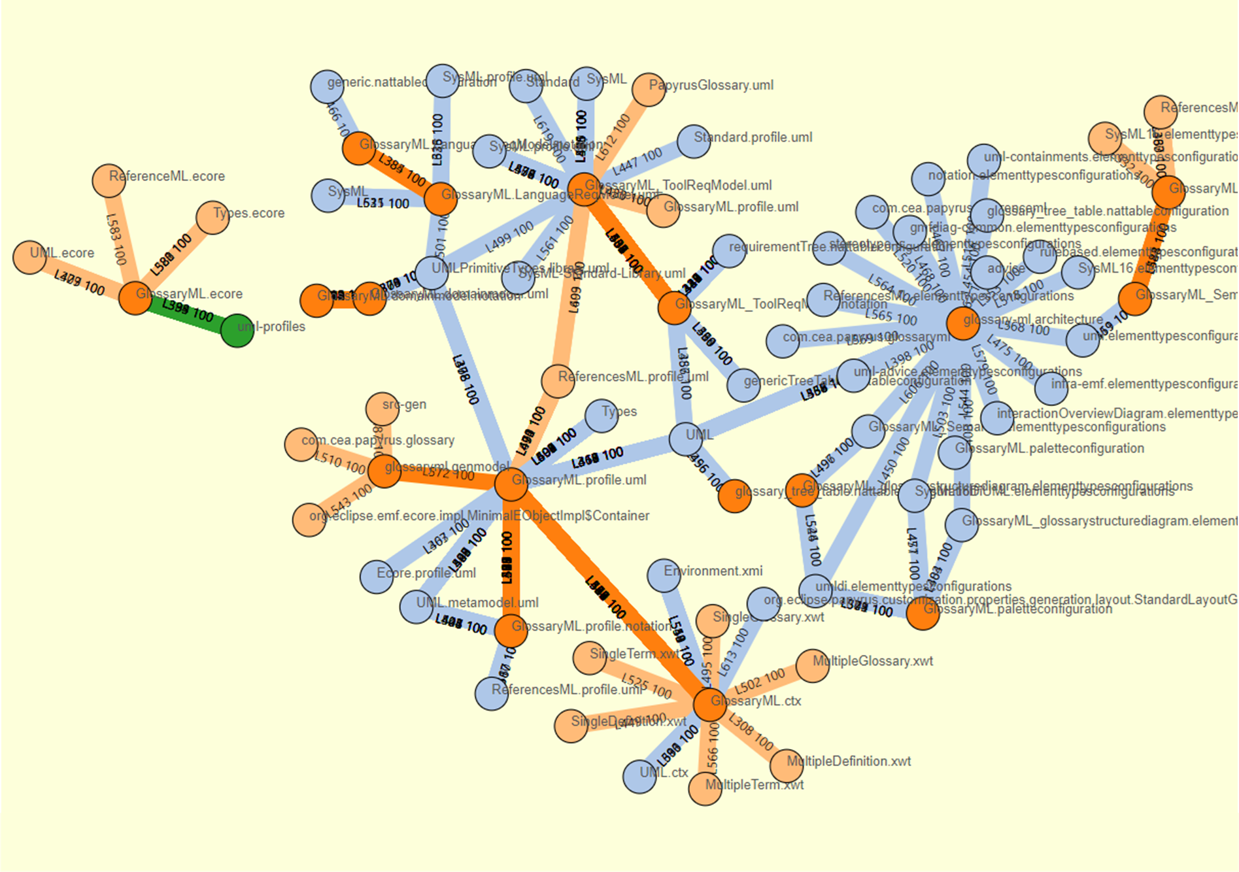
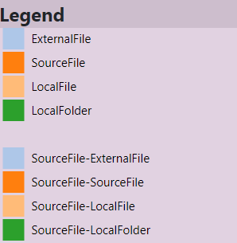
Complexity of
a Papyrus project
Reference forensic
Exploring Papyrus typology

Slide 10
Complexity of
a Papyrus project
Reference forensic
Exploring Papyrus typology

Slide 11
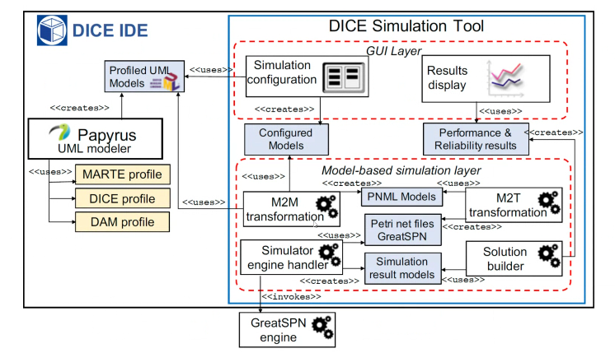
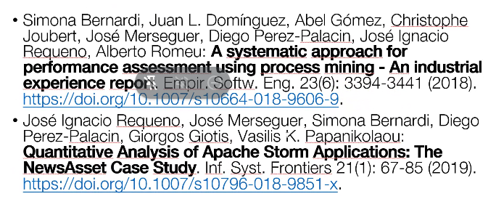
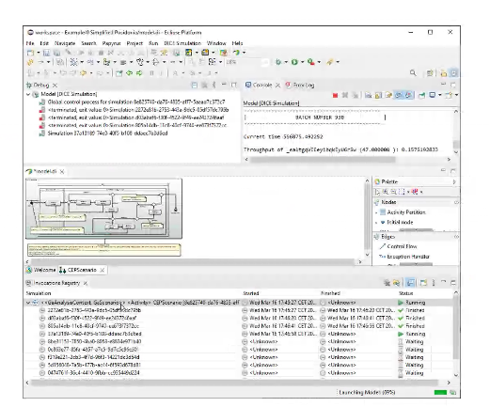
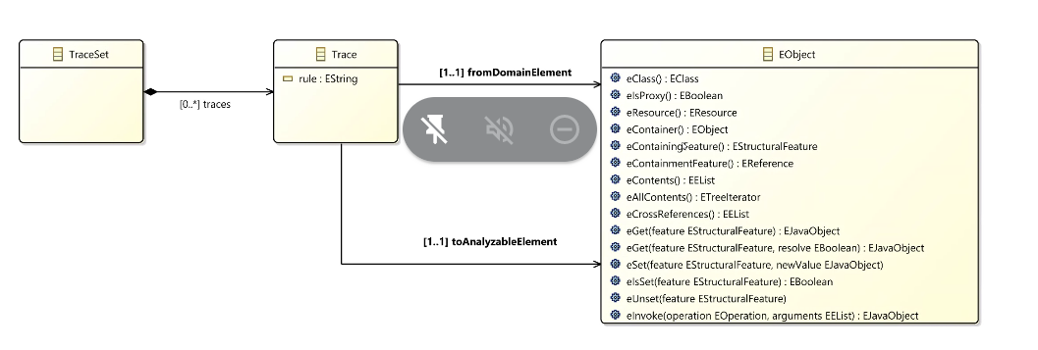

Slide 12
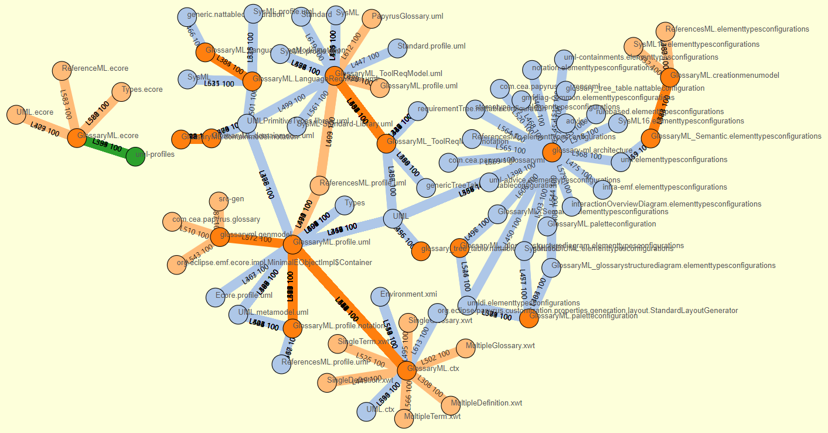
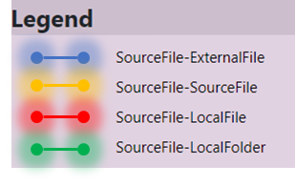
Multi layer graph
Reference forensic
Exploring Papyrus typology
Topology & Complexity =>

Slide 13
Reference forensic
Reference forensic
Exploring Papyrus typology

Slide 14
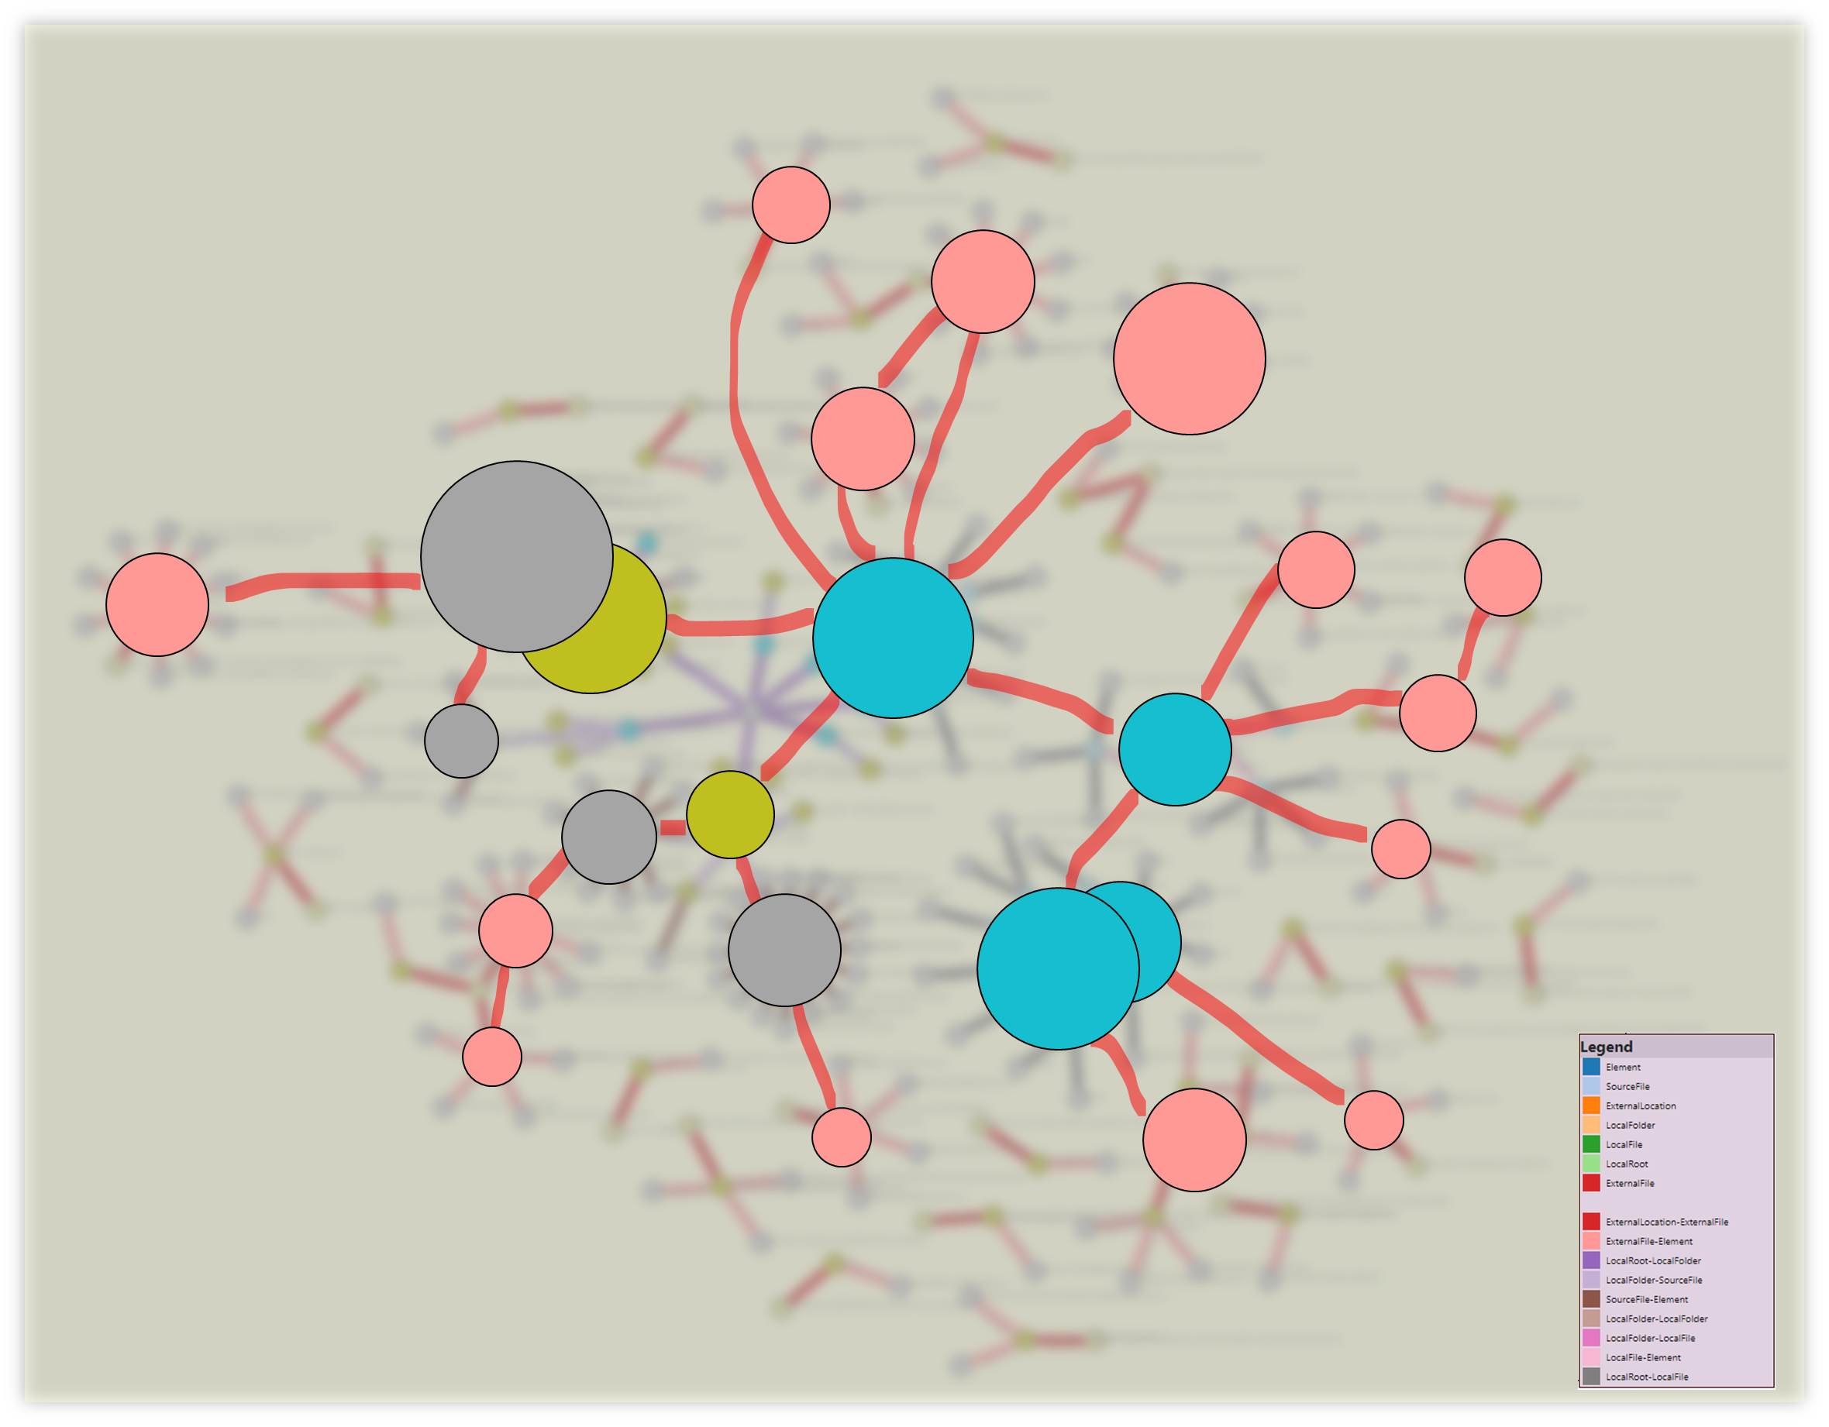
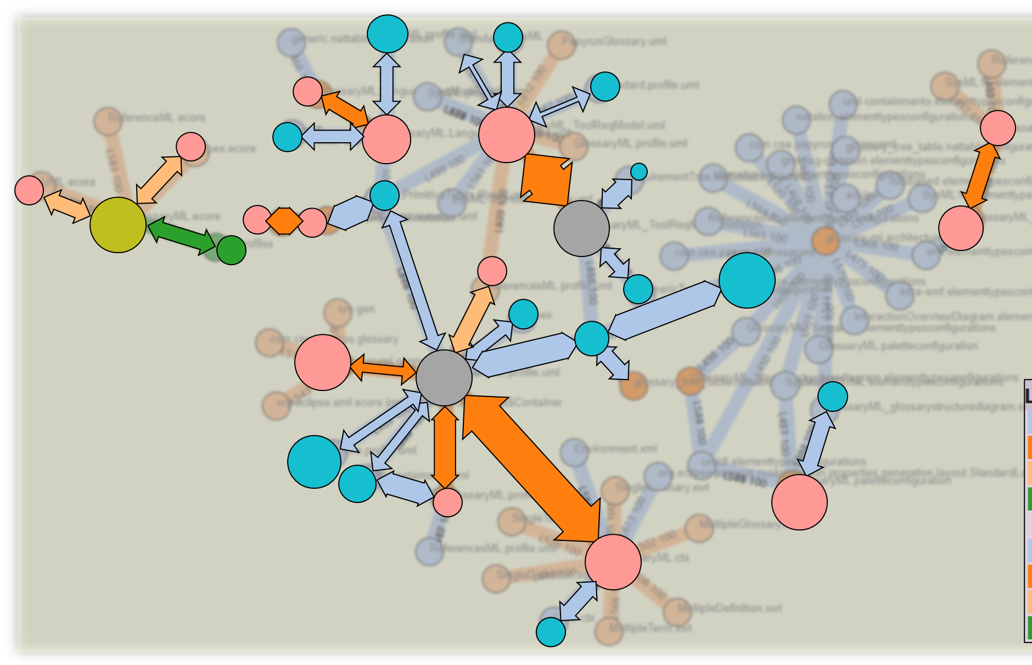
Reference forensic
Topology
Complexity
Reference forensic
Exploring Papyrus typology

Slide 15

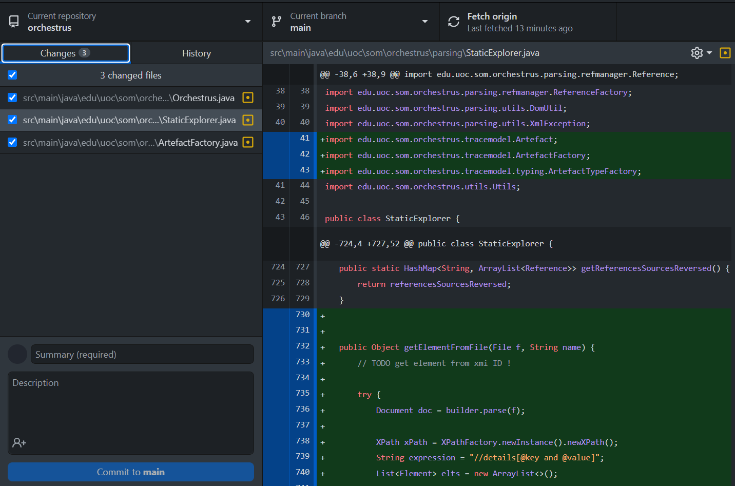
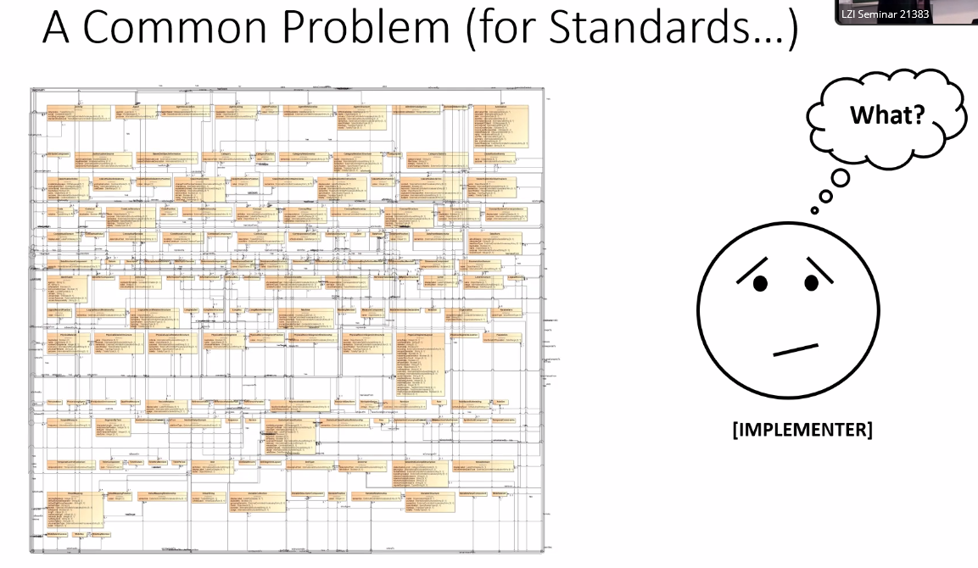
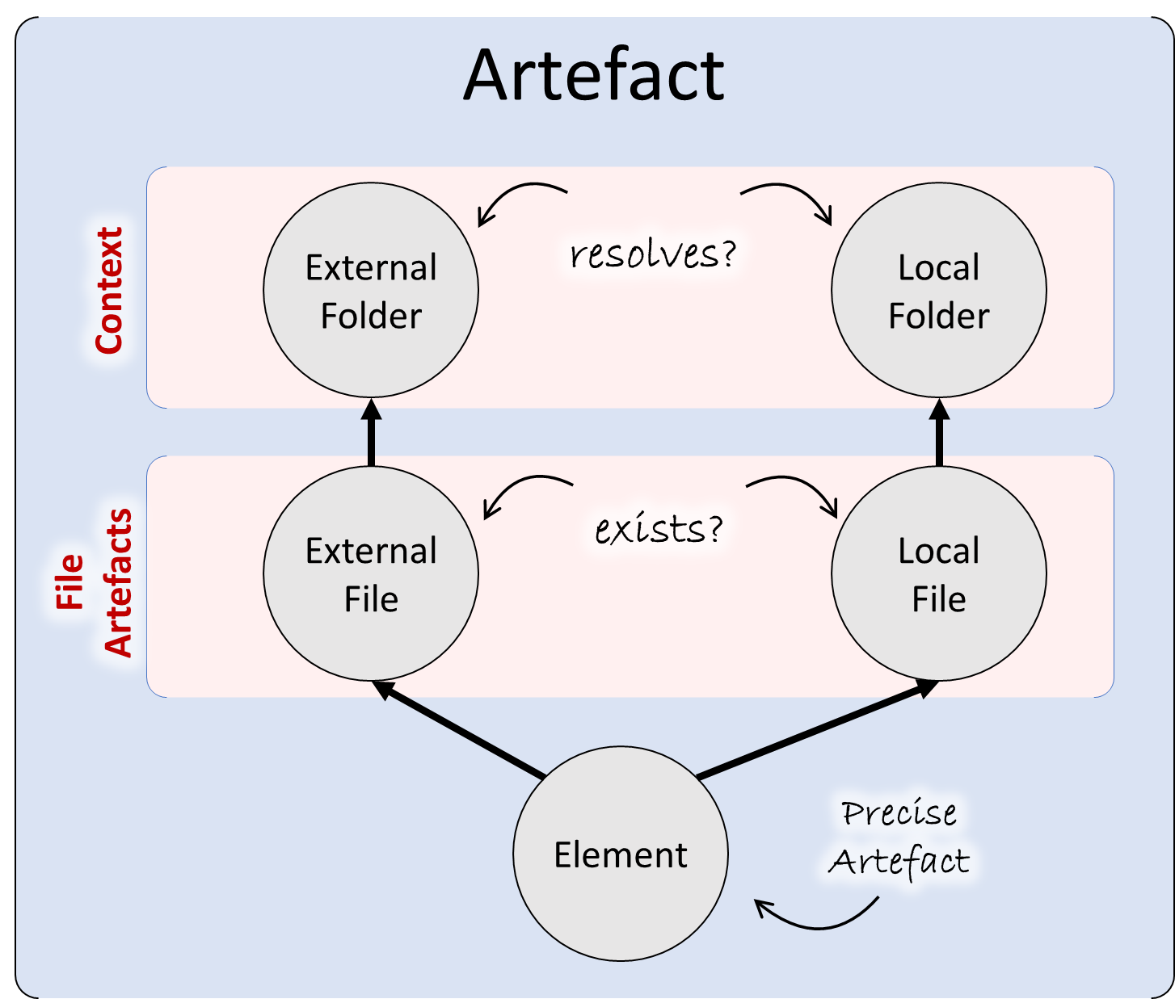
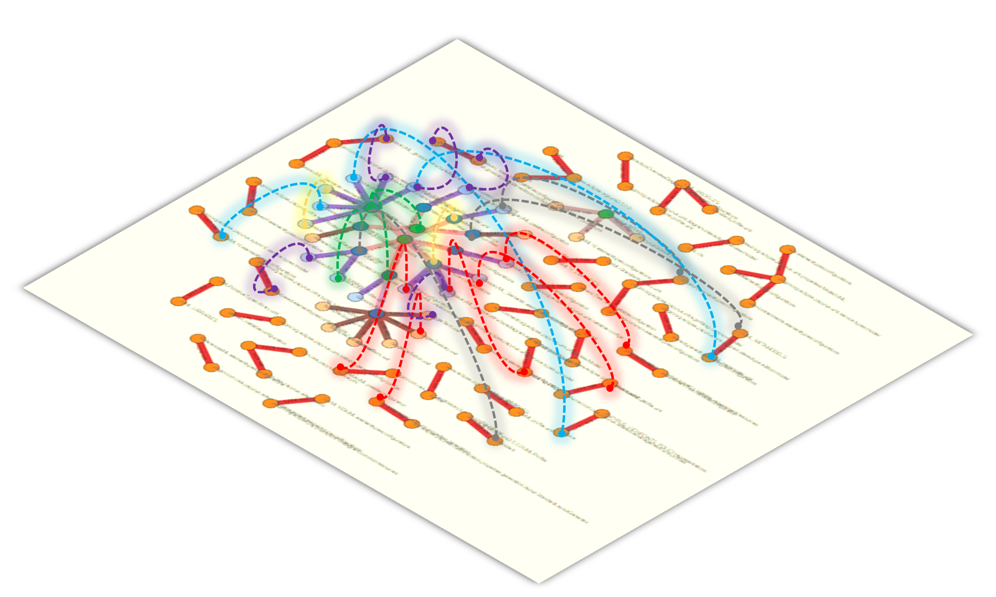
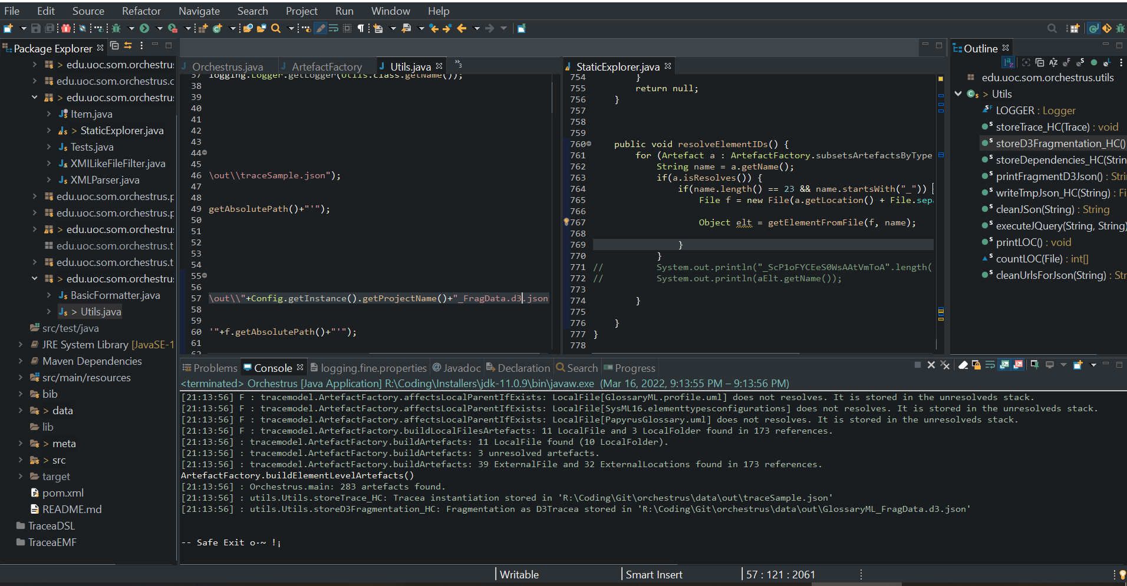

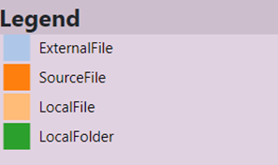
Working space
Reference forensic
Exploring Papyrus typology
Folder
Elt
File
File
File
Folder
Elt
Elt
Elt
Elt
Folder
File
File
Elt
File
File
File
Elt
File
Elt
Elt
Elt
Elt
Elt
Elt
Elt
Elt
Elt
Elt
Elt
Elt
Elt
External Location
External Location
Elt
External Location

Slide 16
Topology and distance in a Papyrus project
Reference forensic
Exploring Papyrus typology
data/input_trace_data.json&nc=4&lc=4

Slide 17
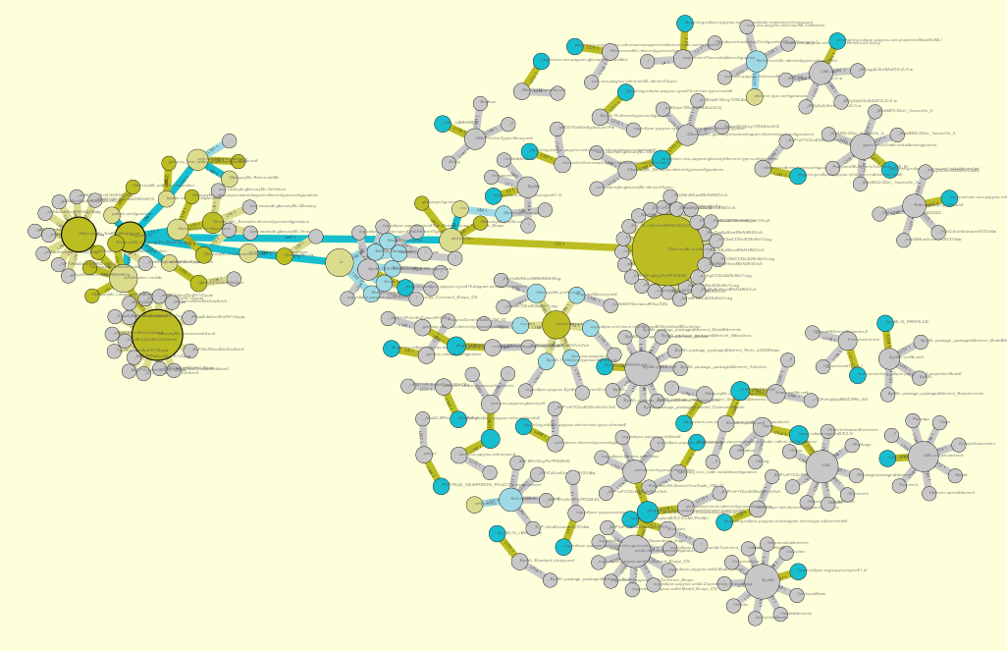
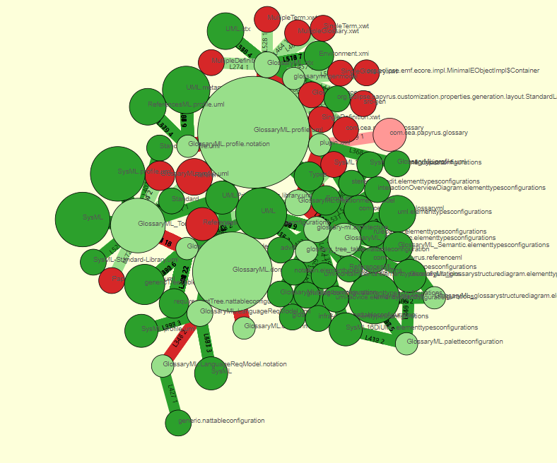
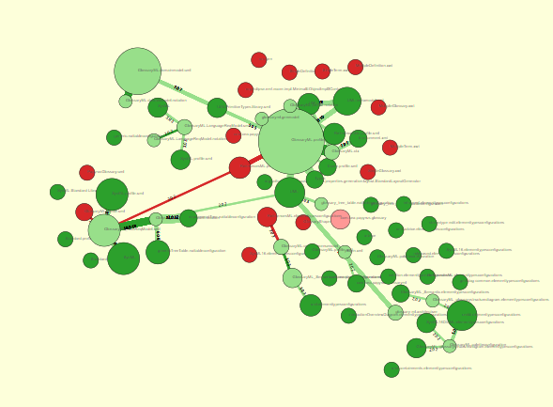
Topology and distance in a Papyrus project
Reference forensic
Exploring Papyrus typology

Slide 18
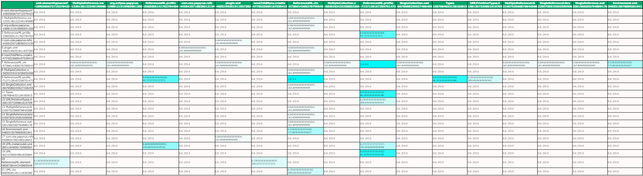
Topology and distance in a Papyrus project
Reference forensic
Exploring Papyrus typology

Slide 19
Topology and distance in a Papyrus project
Reference forensic
Exploring Papyrus typology
The bigger an element,
The most accessed

Slide 20

Complexity of
a Papyrus project
Reference forensic
Exploring Papyrus typology

Slide 21
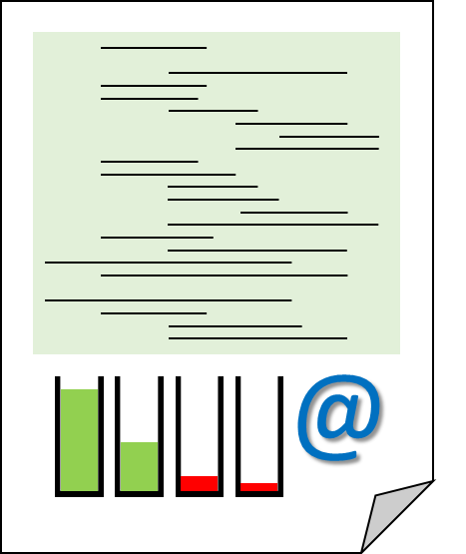
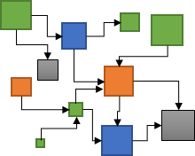
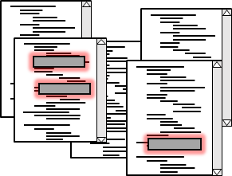
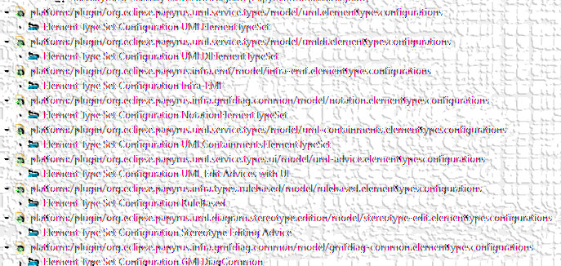
Reference plastic
Artefact
Artefact
Artefact
Protocol
External
Location
Local
Folder
Root
Location
Artefact
Context
resolves?
Name
Inner location
Artefact
External
File
exists?
Local
File
File Artefacts
Element
Precise
Artefact
EMF Realm

Slide 22
EMF Realm

Slide 23

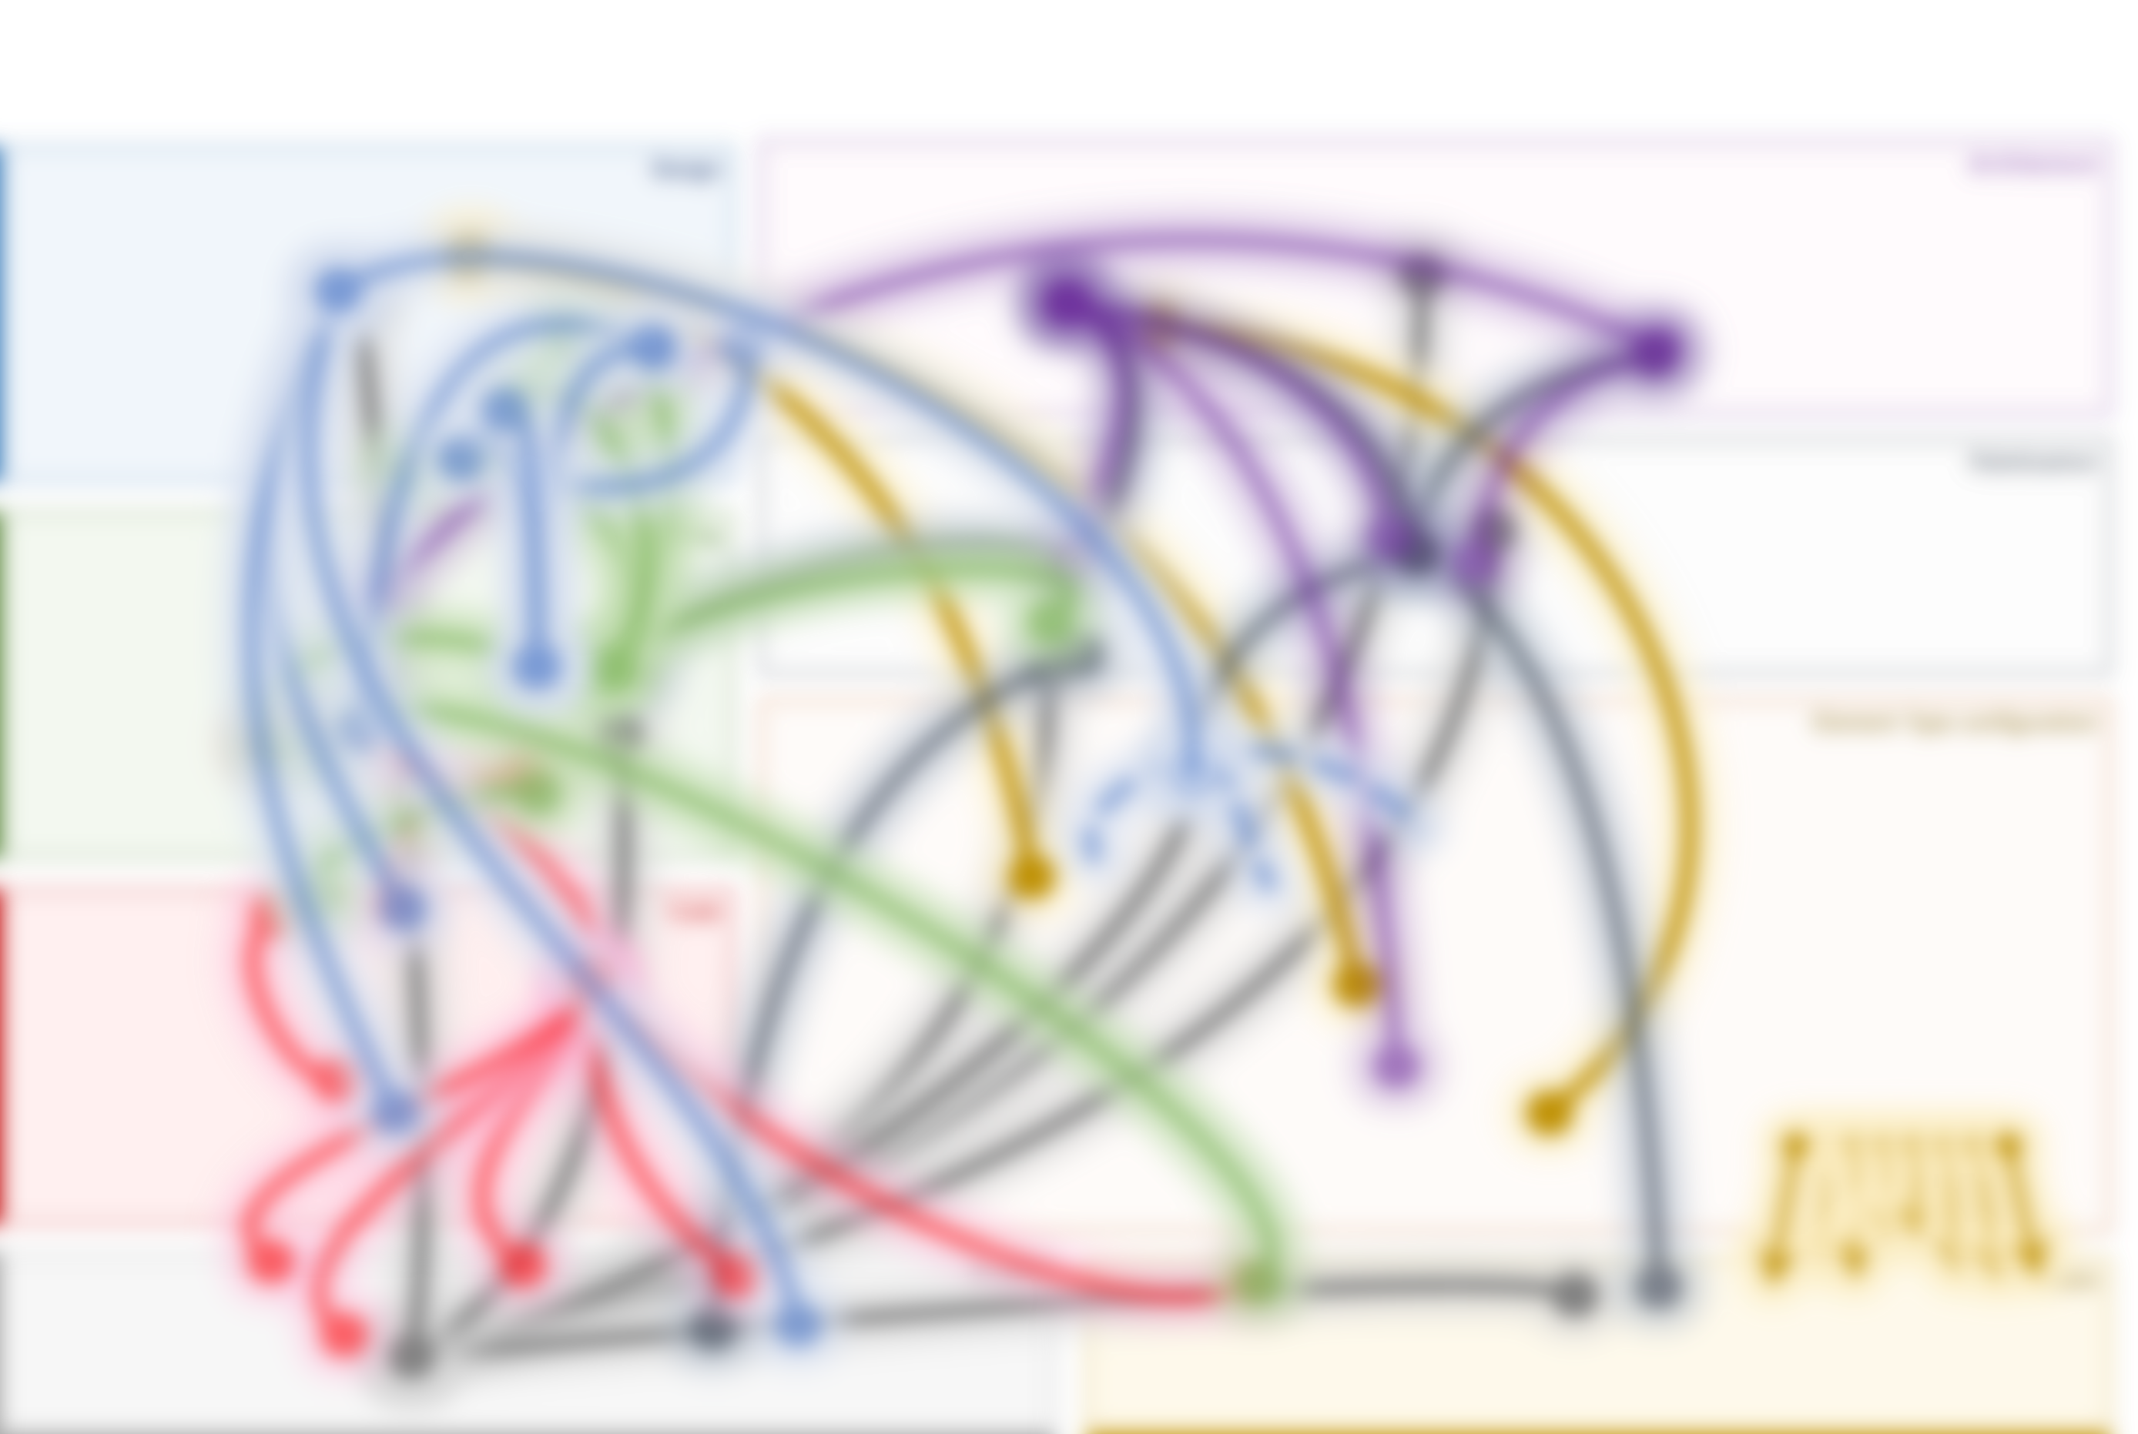
A study of Papyrus: Orchestration for DSL modeling
Inter-module connections
Impacted elements
Design
Code
Inter-module connections map
Profiling
Maps modules external dependencies
Eases exploration of dependencies
Guides type connections
Architecture
Element Type configuration
Palettization

Slide 24
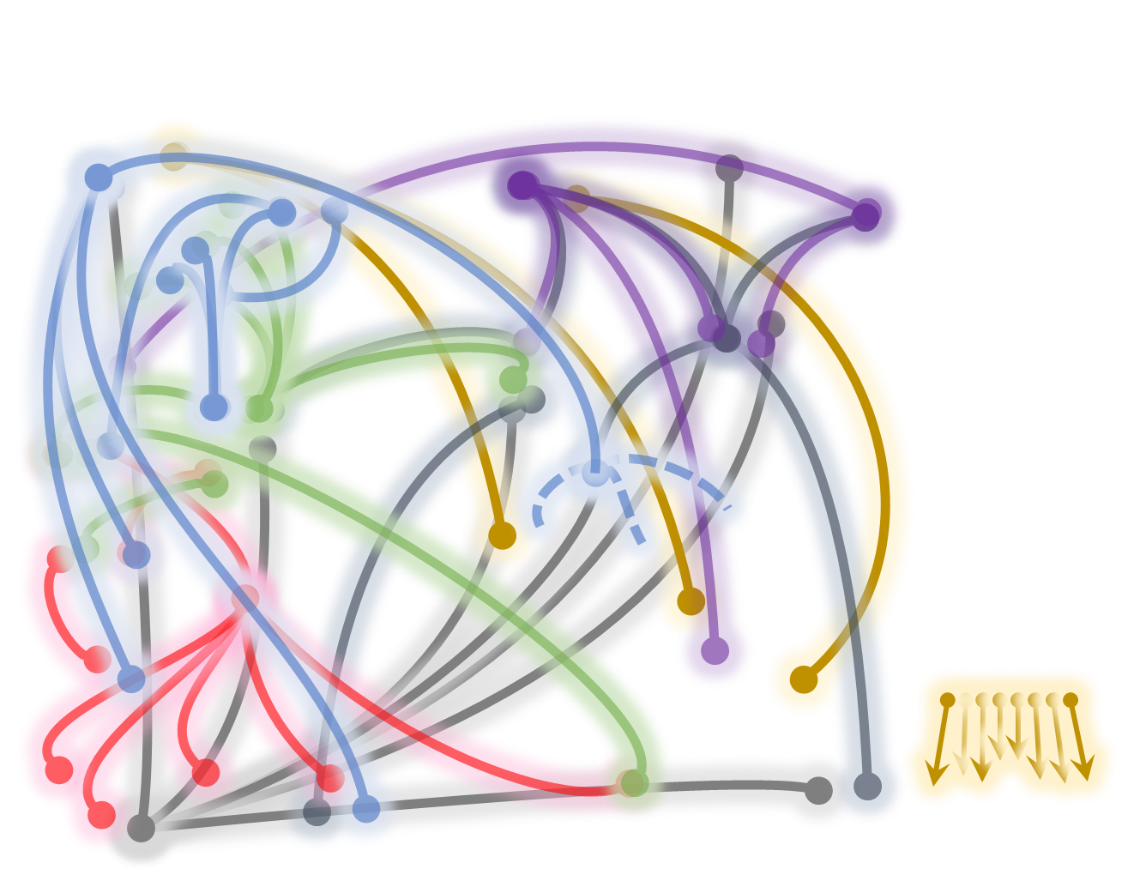
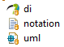
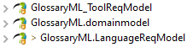


A study of Papyrus: Orchestration for DSL modeling
Inter-module connections detailed
Design
Other modules
UML element
UML Primitives
Related
libraries
SysML element
XML et al.
SysML 1.6
View
Context
Design
Architecture
Profiling
Palettization
Code
Element Type configuration
Related project
Project
EMF Realm

Slide 25
A study of Papyrus: Orchestration for DSL modeling
Inter-module connections detailed
Module
Other modules
Root
Path to element
Path to element
Specific Element
Path to element
External location
Specific Element
Related
libraries
External location
Specific Element
View
Context
Design
Architecture
Profiling
Palettization
Code
Element Type configuration
Related project
Project
EMF Realm

Slide 26




Orchestration for DSL modeling: A study of Papyrus
Element type configurations:
from domain model to EMF representations
? Related projects ?
Glossary
DSL
Reference management DSL

Slide 27

Orchestration for DSL modeling: A study of Papyrus
Customization and dependencies

Slide 28



Orchestration for DSL modeling: A study of Papyrus
Papyrus external elements
Missing
Profile / Definition ?
Domain – SysML
Dependency

Slide 29


Orchestration for DSL modeling: A study of Papyrus
EMF ResourceSets & Resources
Definition
Usages
Related project
CreationMenu resources
Architecture resources

